Slide 1



Slide 2
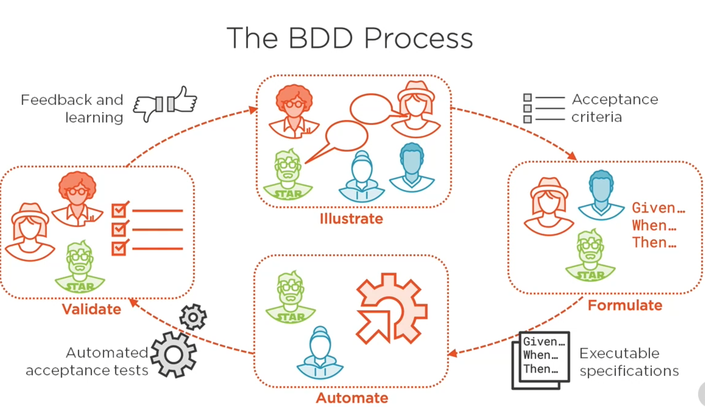

Slide 3
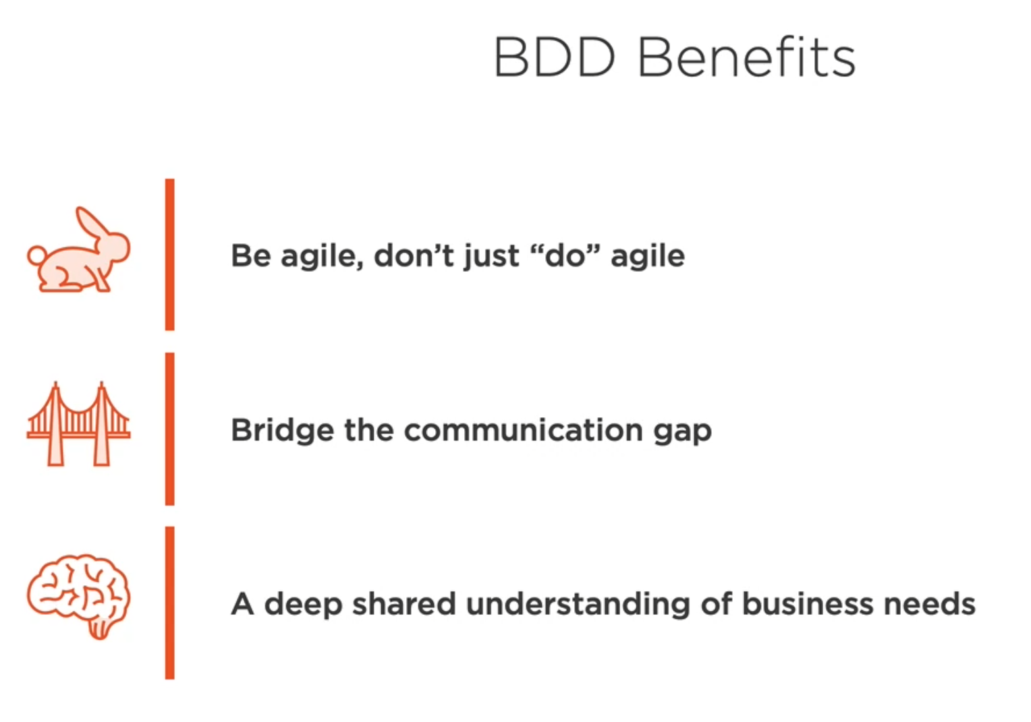
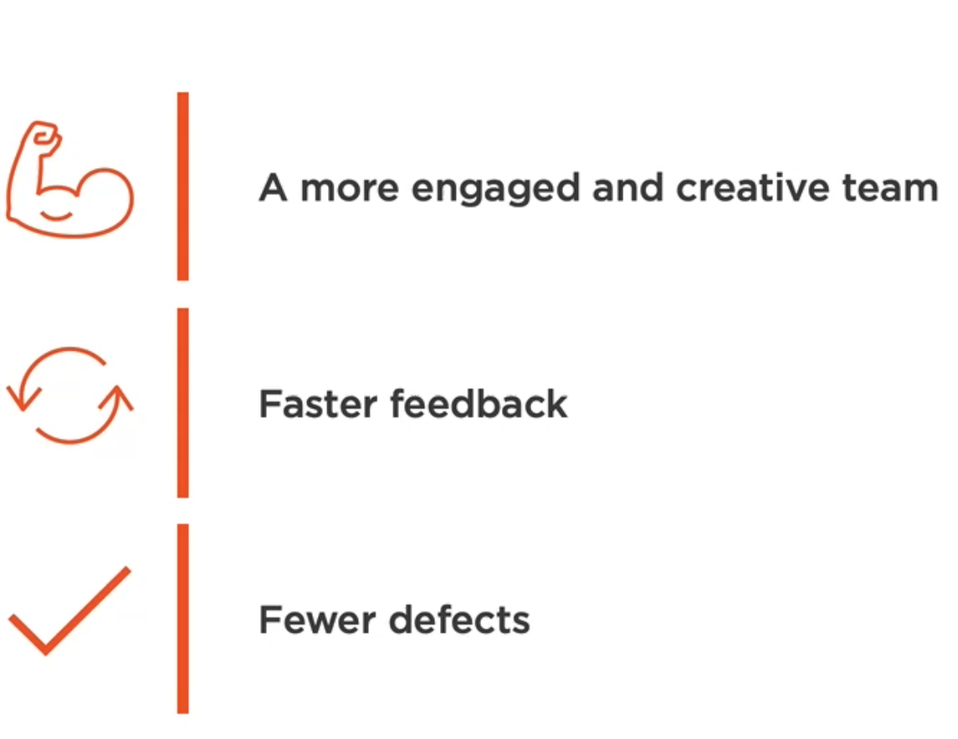

Slide 4
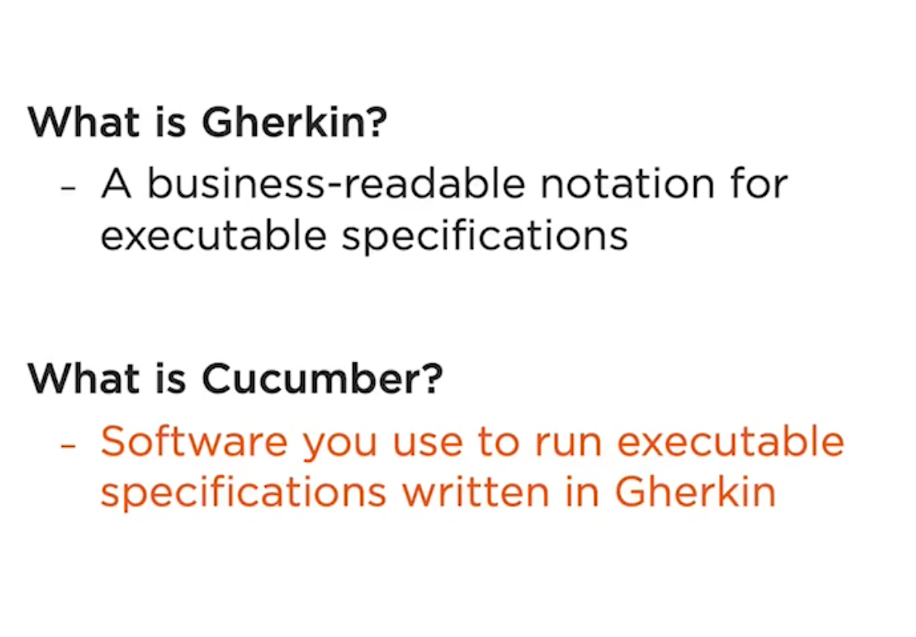

Slide 5
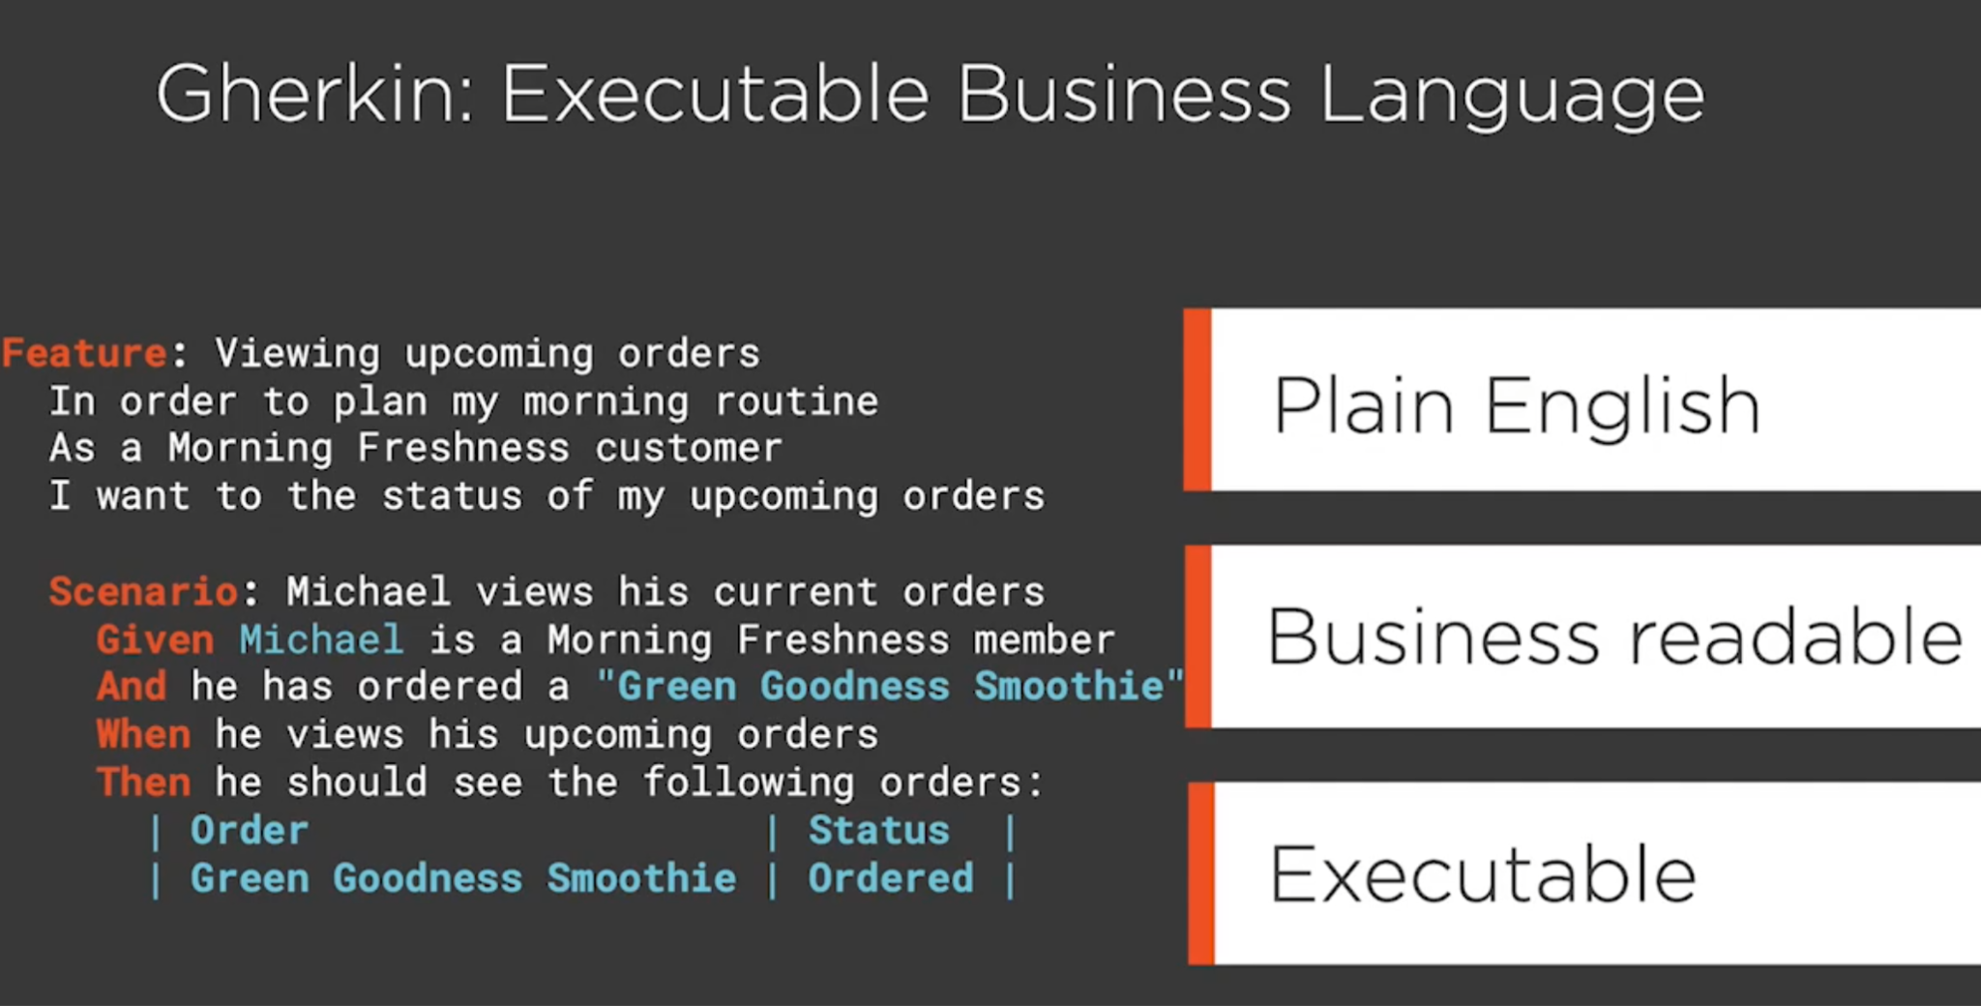

Slide 6
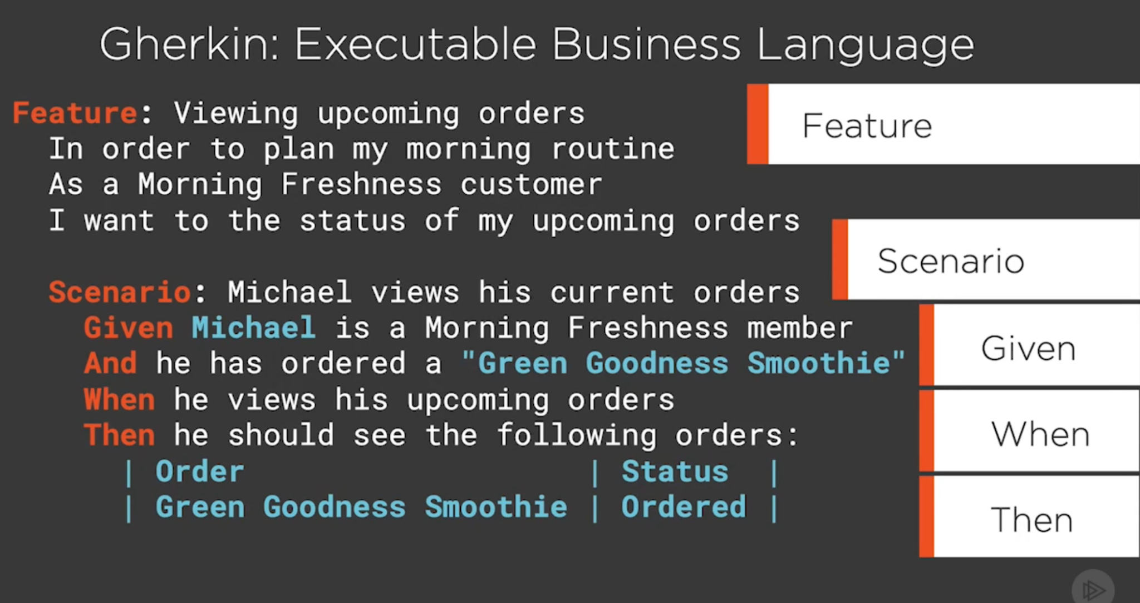

Slide 7
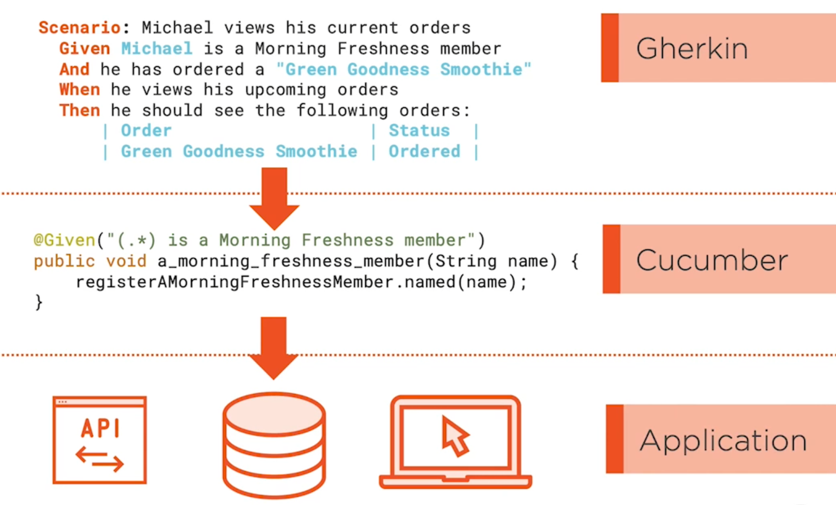

Slide 8
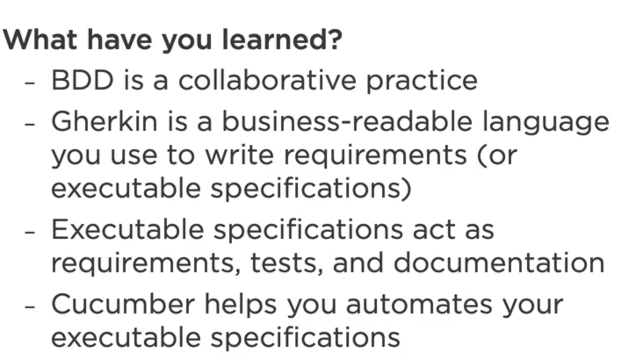

Slide 9
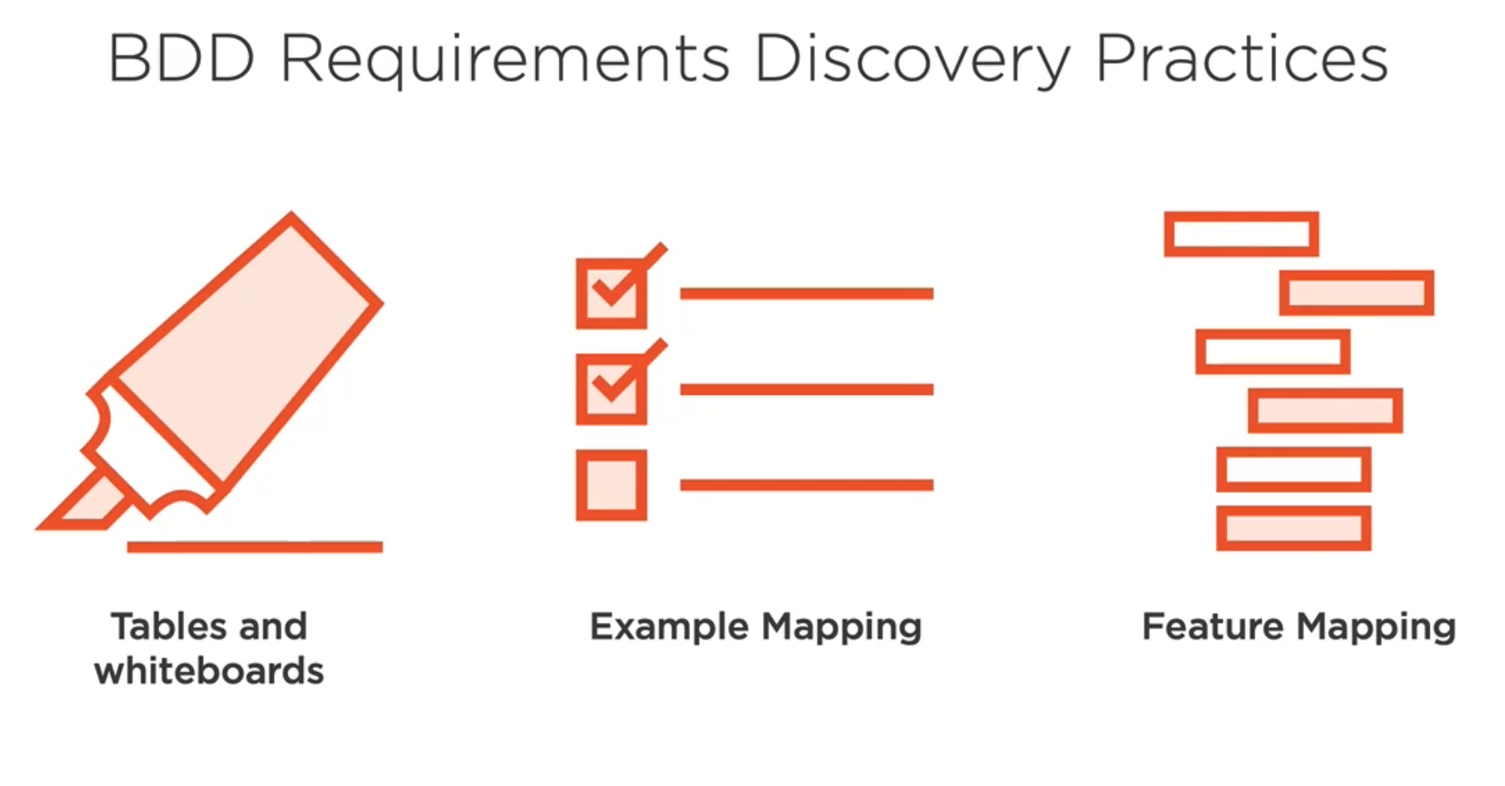

Slide 10
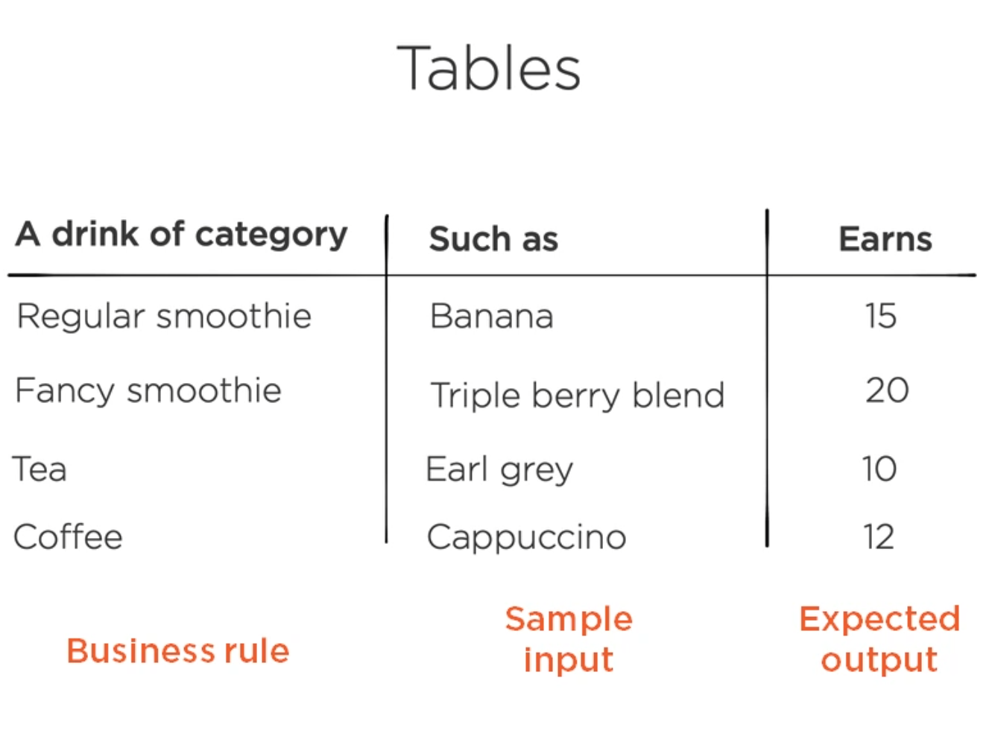
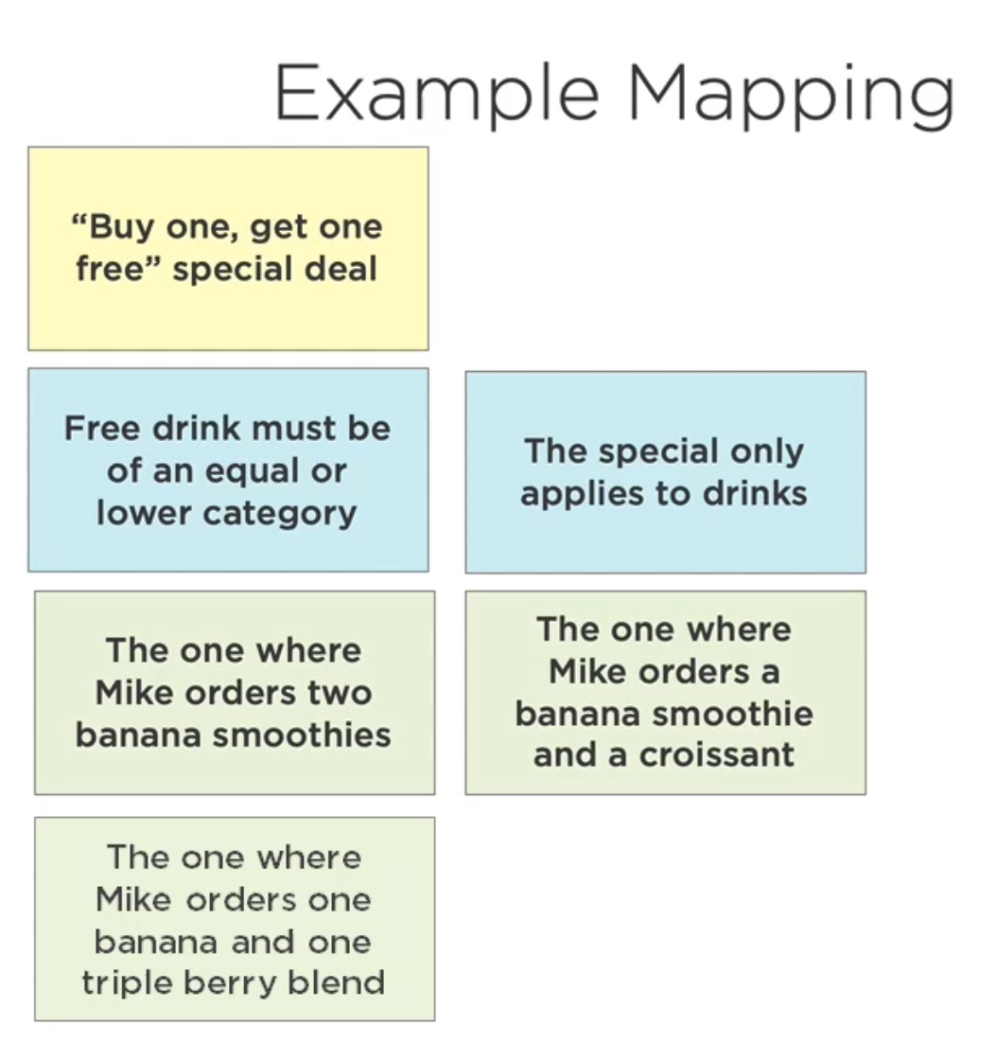
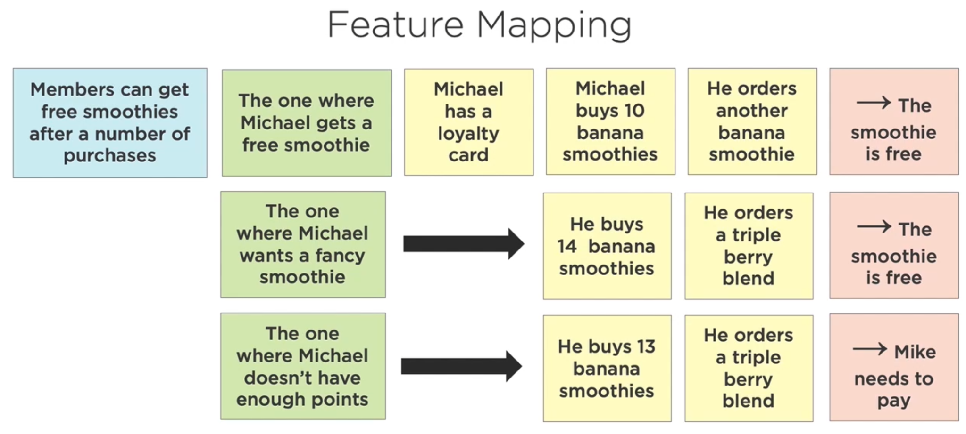
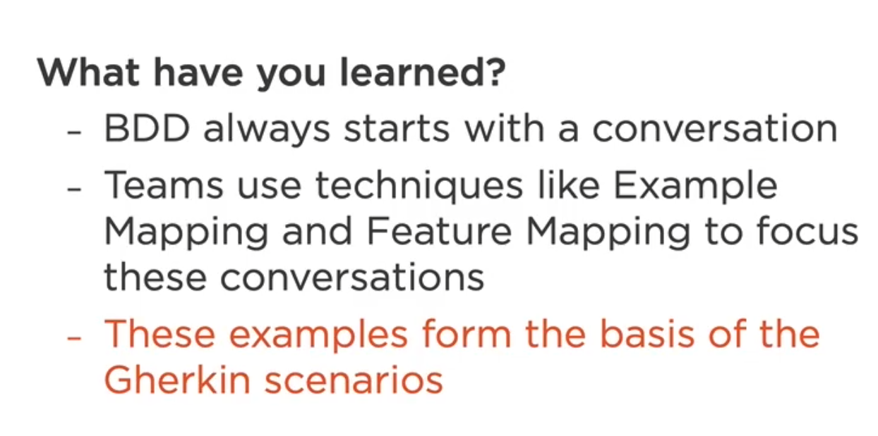

Slide 11

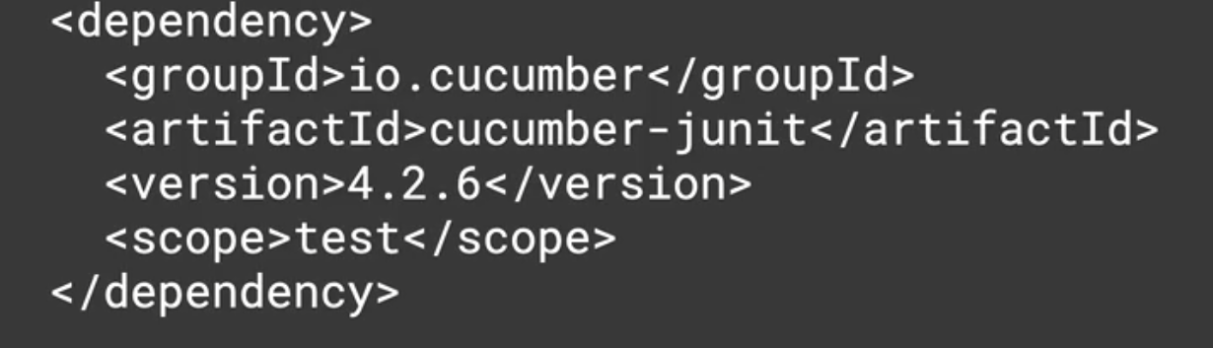
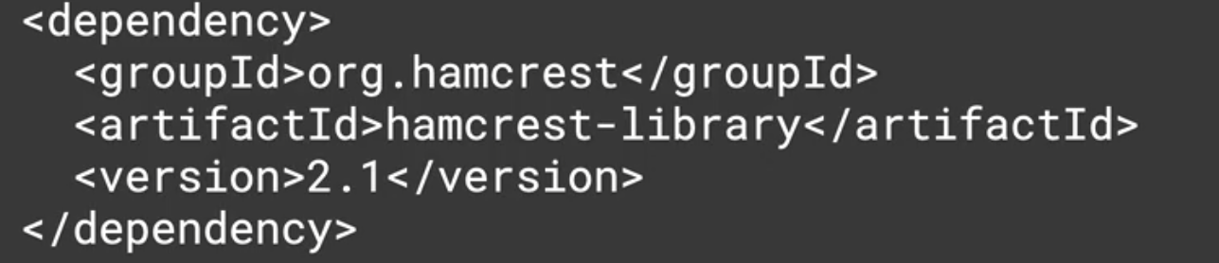
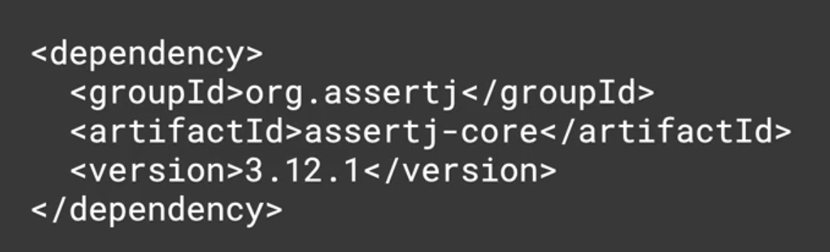
<properties>
<java.version>1.8</java.version>
</properties>
<dependencies>
<dependency>
<groupId>org.springframework.boot</groupId>
<artifactId>spring-boot-starter</artifactId>
</dependency>
<dependency>
<groupId>io.cucumber</groupId>
<artifactId>cucumber-java</artifactId>
<version>7.8.0</version>
</dependency>
<dependency>
<groupId>io.cucumber</groupId>
<artifactId>cucumber-junit</artifactId>
<version>7.8.0</version>
<scope>test</scope>
</dependency>
<dependency>
<groupId>org.hamcrest</groupId>
<artifactId>hamcrest</artifactId>
<version>2.2</version>
<scope>test</scope>
</dependency>
<dependency>
<groupId>org.assertj</groupId>
<artifactId>assertj-core</artifactId>
<version>3.23.1</version>
<scope>test</scope>
</dependency>
<dependency>
<groupId>org.springframework.boot</groupId>
<artifactId>spring-boot-starter-test</artifactId>
<scope>test</scope>
</dependency>
</dependencies>

